Slide 1
Kingdom Prediction
DaSSA Hackathon CU Boulder Nov 5, 2022

Slide 2


Special Thanks to….

Slide 3
Darsh’s only fans! XOXO
Aaron Davis
John Schultz
Thejas Kiran
Tony Lee
Ujas Shah

Slide 4
Data Exploration / Cleaning / Processing
id #
Kingdom (chr)
DNAtype (int)
SpeciesID (int)
Ncodons (int)
Speciesname (chr)
UUU:UGA (num x 64)
DNAtype has 1 NA
Recode (Kingdom, DNAtype) as factor class
Recode UUU and UUC as numeric (bad values become NA)
Remove records with NA values (3)

Slide 5
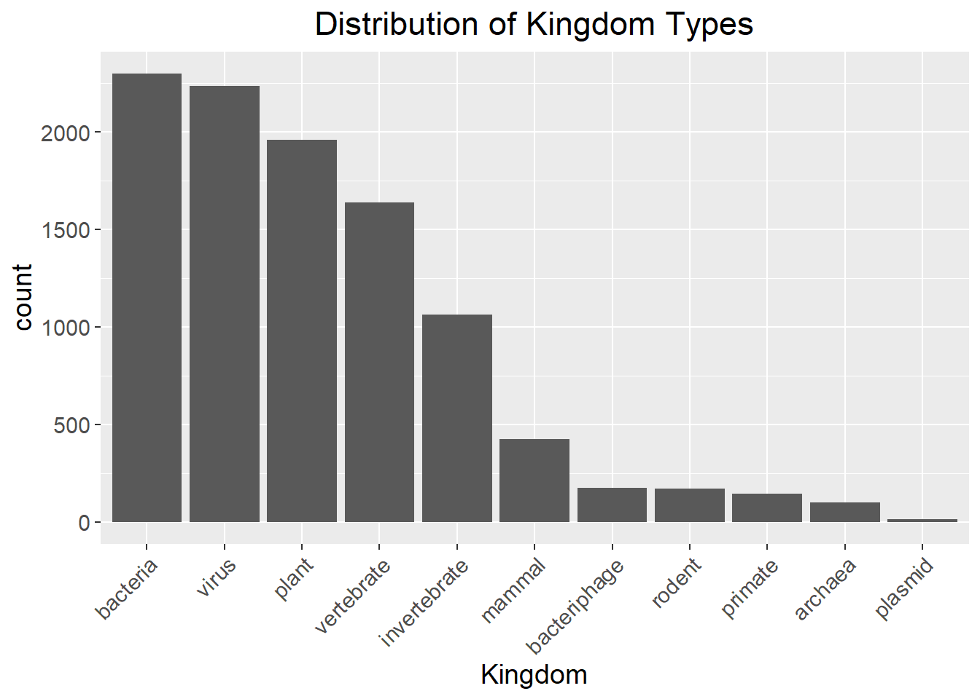
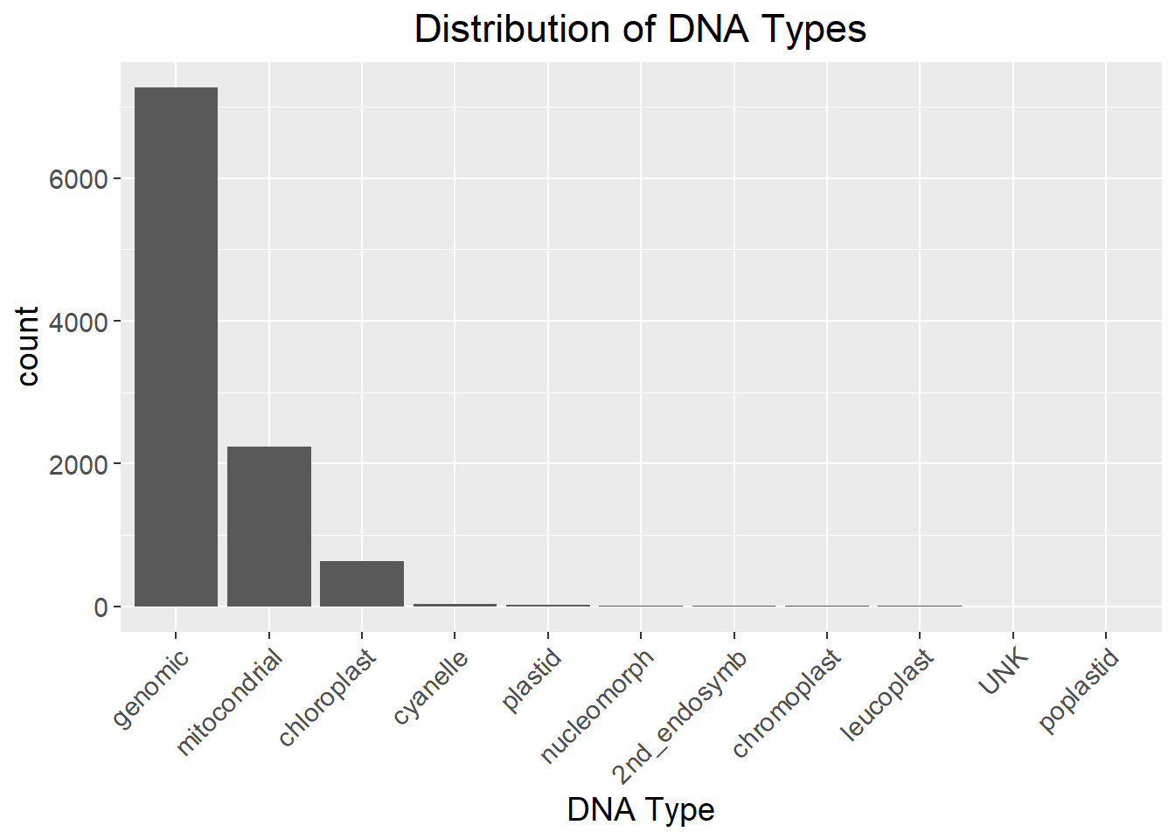
Data Exploration

Slide 6
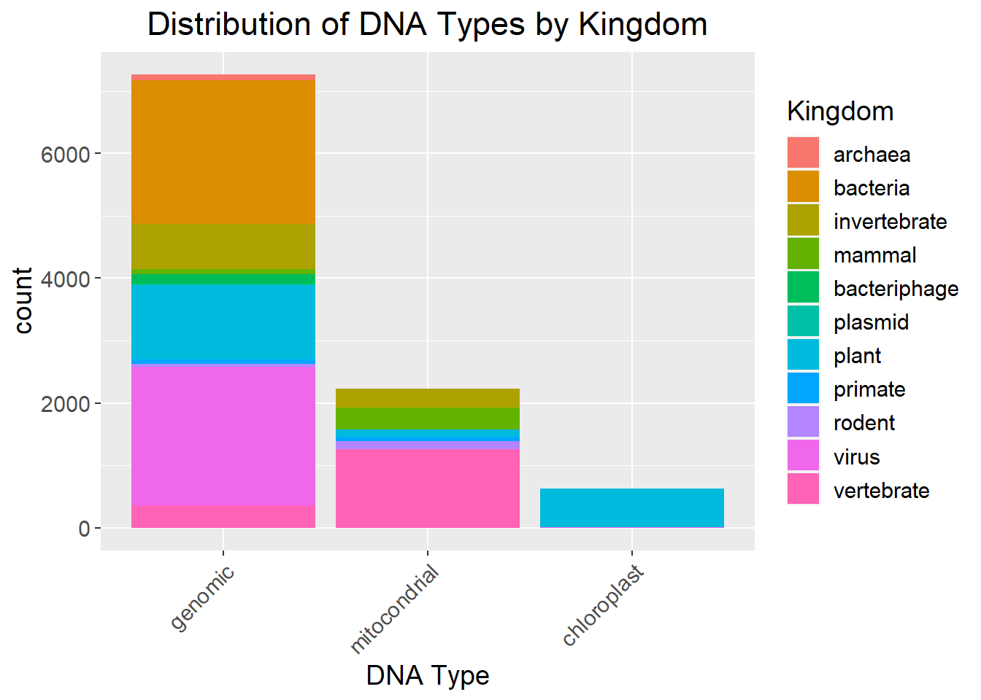
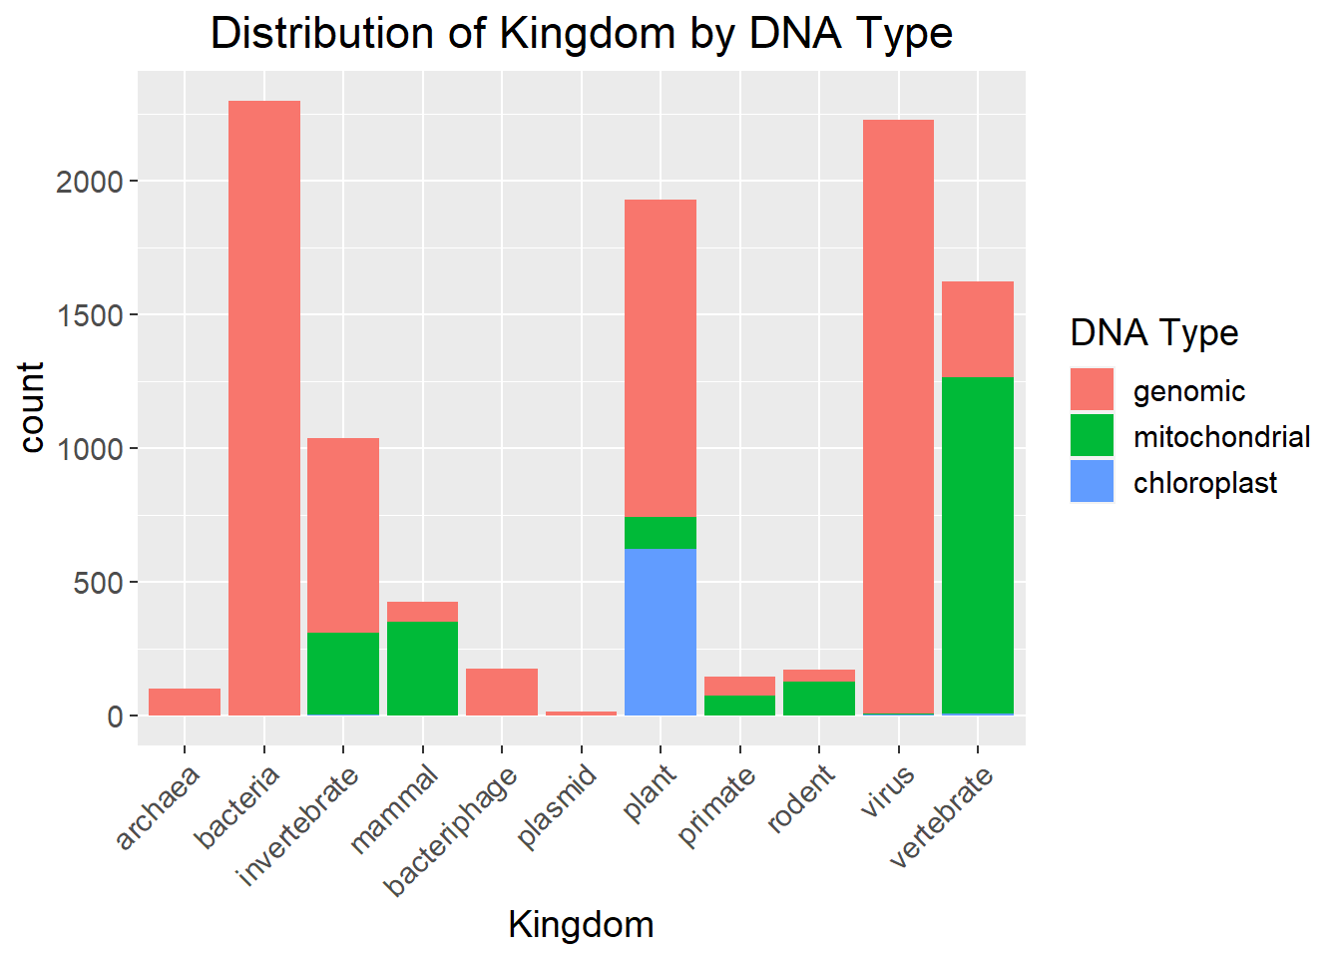
Data Exploration

Slide 7
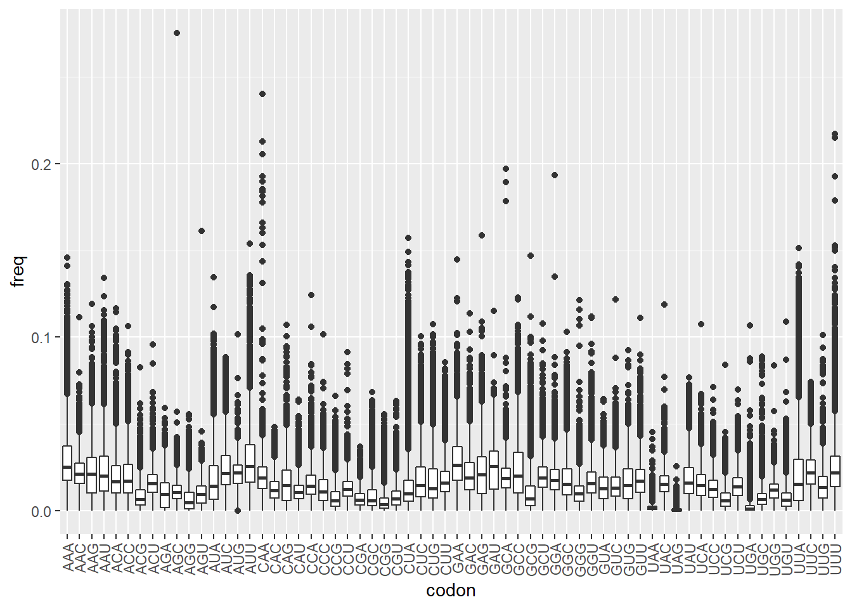
Data Exploration

Slide 8
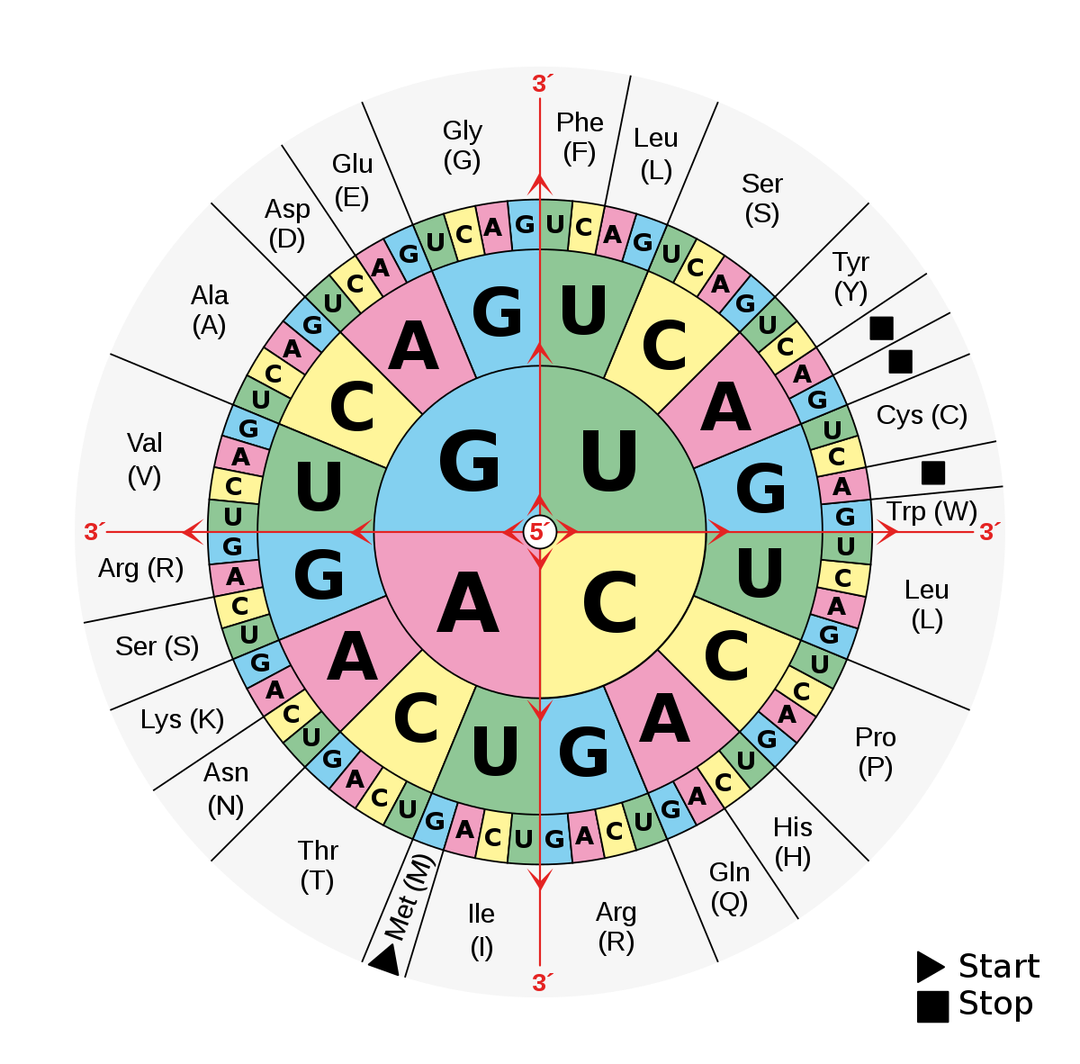
Feature Engineering
Consolidate (64 codons) to (20 amino-acids + stop code)
Future Feature Engineering:
Codon usage bias
Normalize the proportions of codons for each amino acids to create a unique fingerprint
Arginine (Arg) / (R)
CGG
CGA
CGC
CGU
0.2
0.1
0.6
0.1

Slide 9
Modeling
Models tried
Model | Accuracy
KNN Clustering | ~93%
XGBoost | ~92%
Random Forest | ~89%
SVM | ~87%
Naive Bayes | ~65%

Slide 10
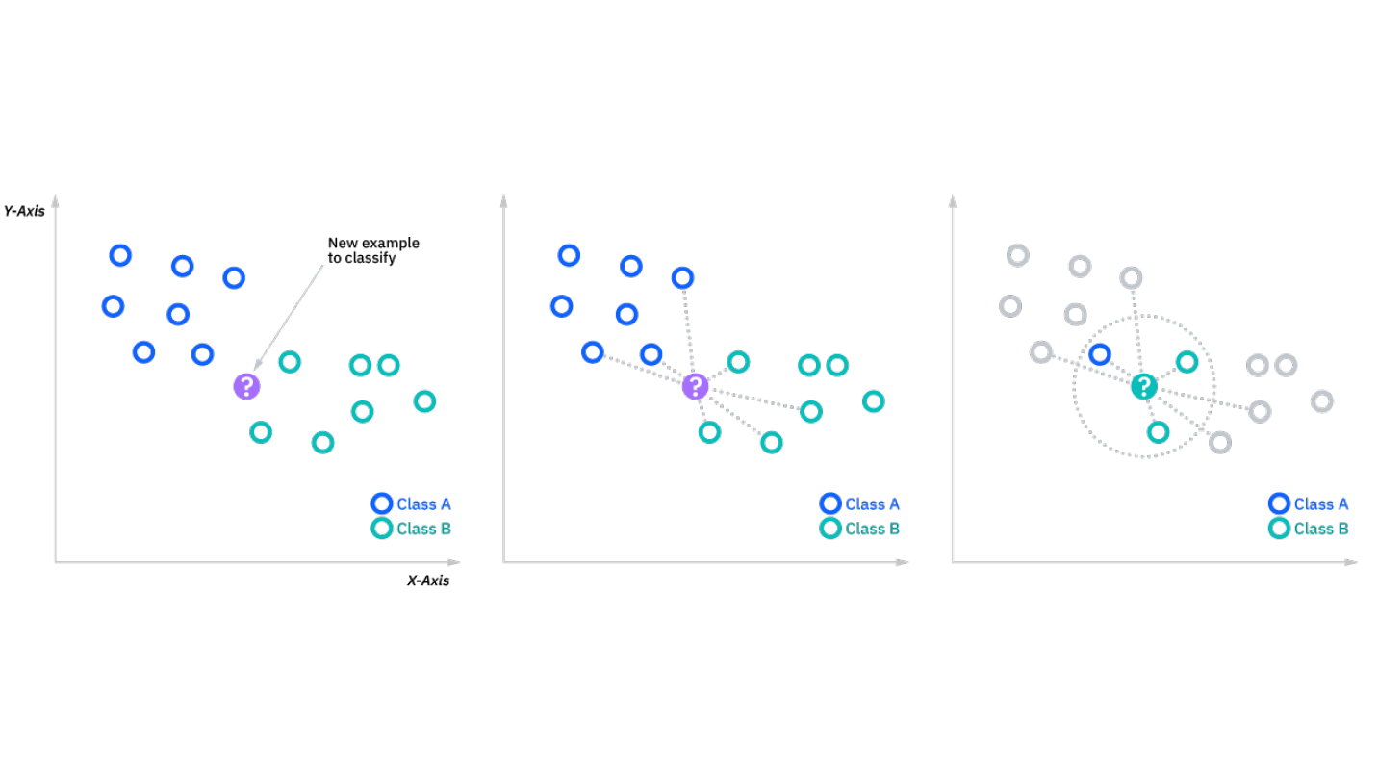
Under the Hood – How the Model Works
Picture: A KNN model, source

Slide 11
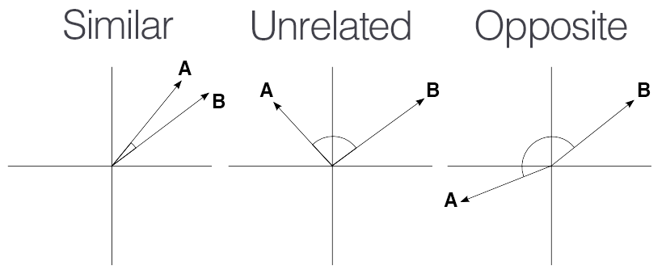
Hyperparameter Tuning
Hyperparameters tuned for the KNN model
K- 3
Distance- cosine
Algorithm- brute
Weights- distance
Picture: Cosine similarity, source

Slide 12
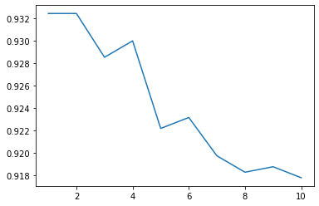
Accuracy Report
Choice of Metric
Metric Explained:
TP+TN / Total
Accuracy for different K’s in KNN
Accuracy
N

Slide 13
Conclusion
Kingdom prediction is possible with codon frequency
In our experience a KNN model worked the best

